Slide 1
Application of Falsification Methods on the UxAS System
Cumhur E. Tuncali, Georgios Fainekos
Arizona State
University
Bardh Hoxha
Southern Illinois University
bhoxha@cs.siu.edu
www.bhoxha.com
Guohui Ding, Sriram Sankaranarayanan
University of Colorado
Boulder
NASA Formal Methods 2018
Newport News, Virginia, USA, April 18
The authors authorize the public release of this presentation
Notes:
Application of Falsification Methods on the UxAS System
Joint work with ….

Slide 2


Summer Of Innovation 2017
Participants from the industry, academia, and the government
Apply formal methods to the AFRLs UAV mission planning software UxAS
Requirement formalization • Formal architecture description • Methods for proving correct and safe behavior • Cyber-security considerations • Real-time scheduling/enforcement • Automated test generation • Argumentation and assurance cases • Run-time assurance • Hybrid systems analysis • Improvements in mission and task planning
Automated test generation
Notes:
This work was conducted during the Summer of Innovation project in 2017. This is a partnership with the Air Force Research Laboratory, Wright Brothers Institute, and approximately 16 other contracted partners from academia, government, and industry.
(UxAS) contains about 50 state of the art cooperative control, path planning and surveillance software services.
Each team worked on various topics in verification

Slide 3
1. UxAS and AMASE

Slide 4
From Mission Scenarios to Simulation
UxAS
Route Planner
Mission
AMASE
Automation
Autopilot Waypoint Tracking
Scenario
Vehicle Abstract
Vehicle
States
Available Vehicles
…
Operating Regions and Keep Out Zones
Line Search Task
Waypoints
Area Search Task
…
Overwatch Task
…
https://github.com/cmcghan/OpenUxAS
https://github.com/cmcghan/OpenAMASE
Notes:
UxAS: Unmanned Systems Autonomy Services
Highly modular software system for multi-UAV cooperative decision making
Services share a channel of communication.
AMASE: AMASE is a aircraft dynamics simulation toolset.
AMASE roughly simulates the behavior of the Piccolo autopilot over these waypoints and periodically publishes aircraft positions and head- ings back to UxAS as the simulation progresses.
The waypoints are provided to AMASE in batches.
The system has been utilized in military exercises and maybe more (not sure)

Slide 5
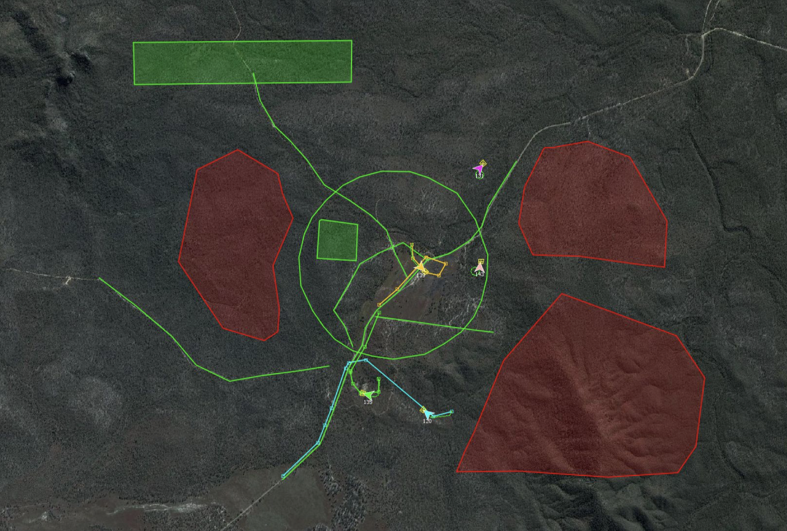
Tasks
[Slide adopted/modified from D. Fisher, S5 2017]
Notes:
Here we can see 5 UAVs
The green lines are line search tasks – UAV have to utilize their cameras, which are on a gimbal, to conduct line search
The green polygons are area search tasks
The red polygons are keep out zones

Slide 6
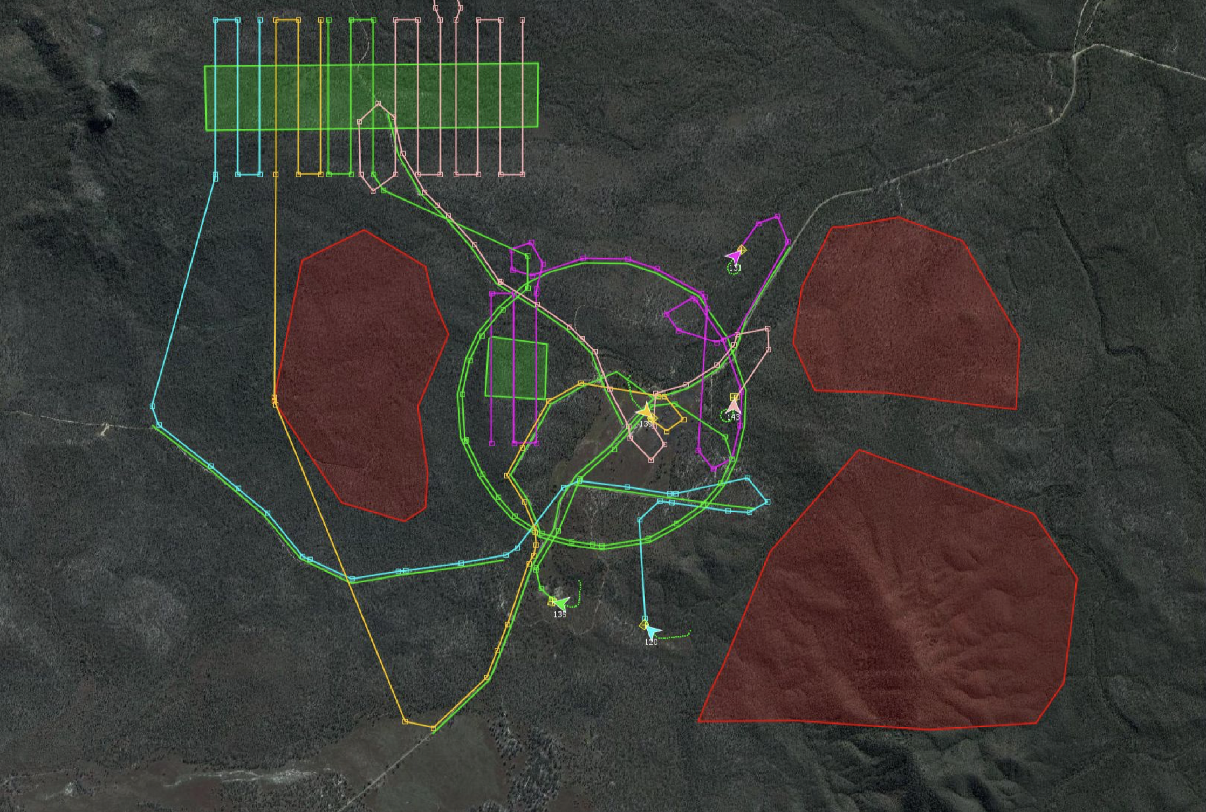
Assignment
[Slide adopted/modified from D. Fisher, S5 2017]
Notes:
Branch and bound algorithm assigns task for each vehicle and generates the inputs.
You can notice that the area search task is split up between several UAVs

Slide 7
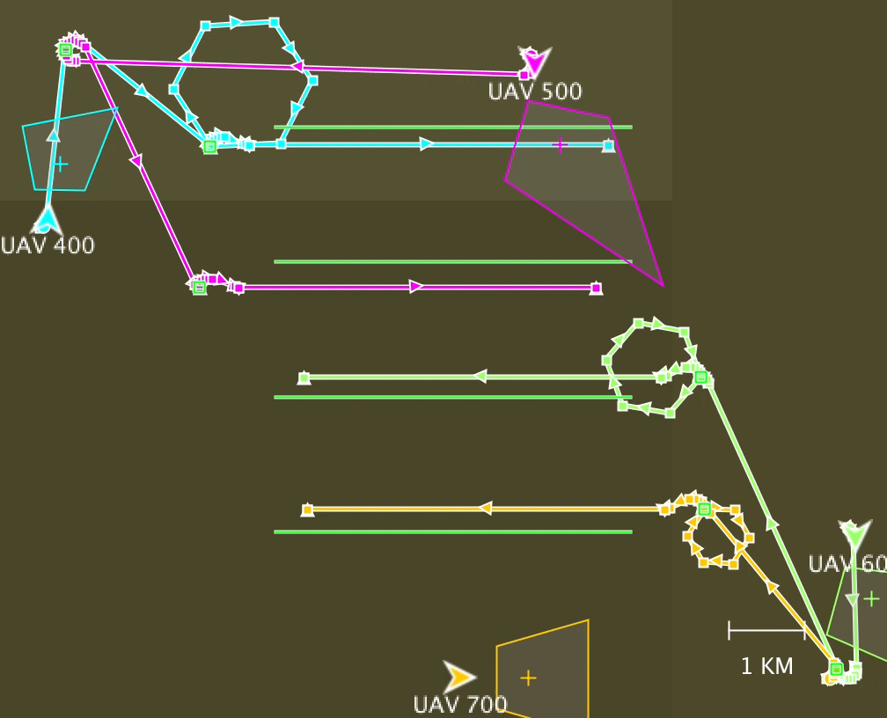
Synchronized Firefight
🔥
🔥
🔥
🔥
https://youtu.be/rgerTBylMsc
[ASU – SIU – VU]
[ADHS2018]
Notes:
Branch and bound algorithm assigns task for each vehicle and generates the inputs.
You can notice that the area search task is split up between several UAVs

Slide 8
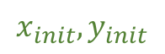
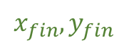
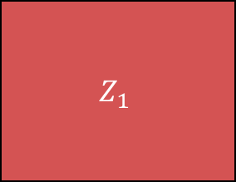
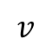
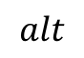

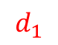
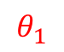
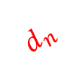
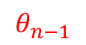
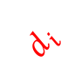
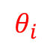
Testing UxAS: Keep Out Zone Violations
💨
GPS
$$Z_{1}$$
$$d_{n}$$
$$x_{fin},y_{fin}$$
$$alt$$
…
$$θ_{n−1}$$
$$v$$
$$d_{i}$$
$$θ_{i}$$
$$d_{1}$$
…
$$Z_{2}$$
$$x_{init},y_{init}$$
$$θ_{1}$$
Notes:
How will we test UxAS?
We will generate a random task – in the case of line search we will define a random path between two points.
However, we want to make sure that the UAV does not violate the keep out zones.
Under disturbances such as wind or gps disturbances with different vehicle operating conditions.
Note that reasonable bounds were established in collaboration with the AFRL folks.

Slide 9
2. Robustness-Guided Testing

Slide 10
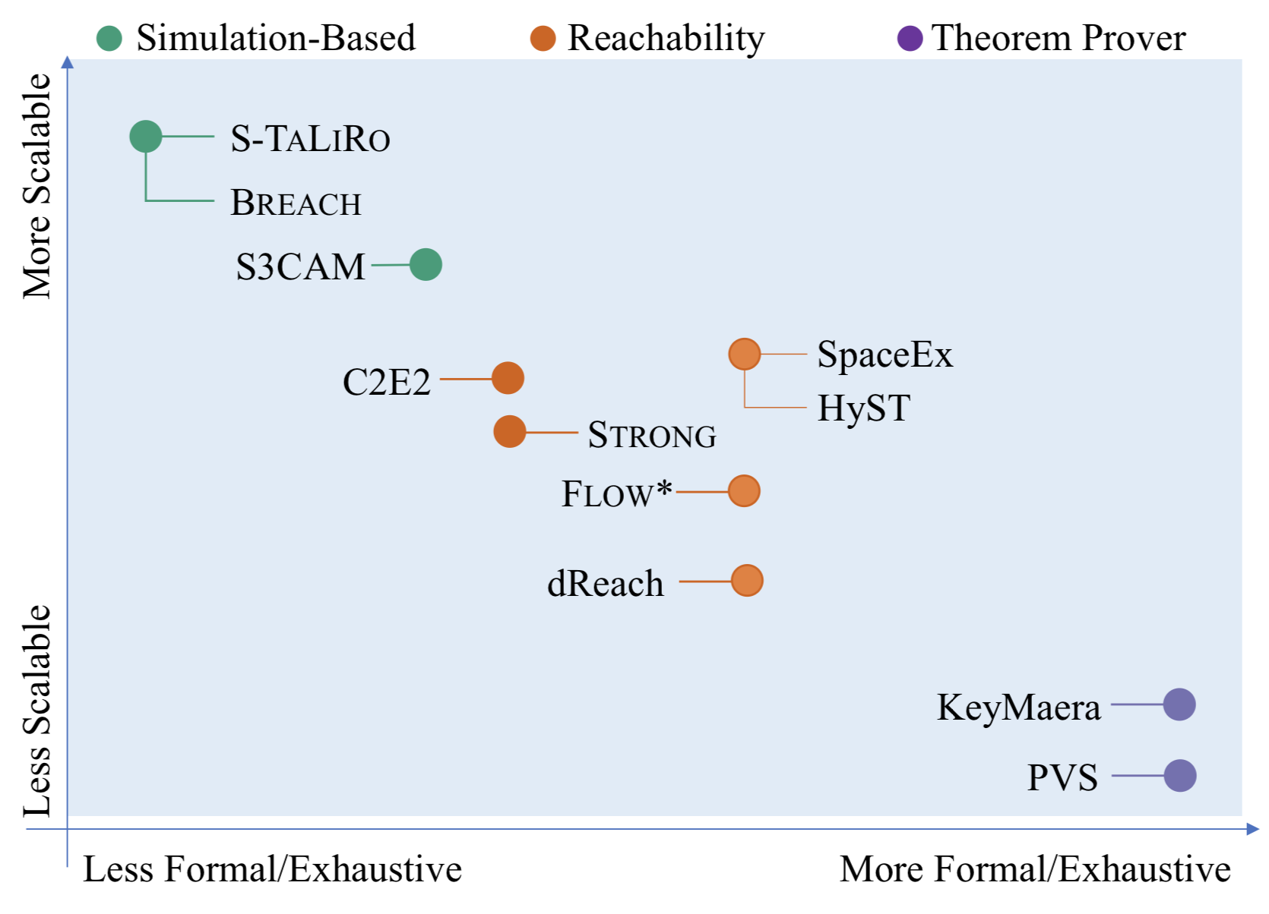
Methods and Tools
Notes:
If we look at spectrum of methods and tools in verification
x-axis scalability
y-axis how formal/exhaustive
We are here
Fast
Easy to use with black-box

Slide 11
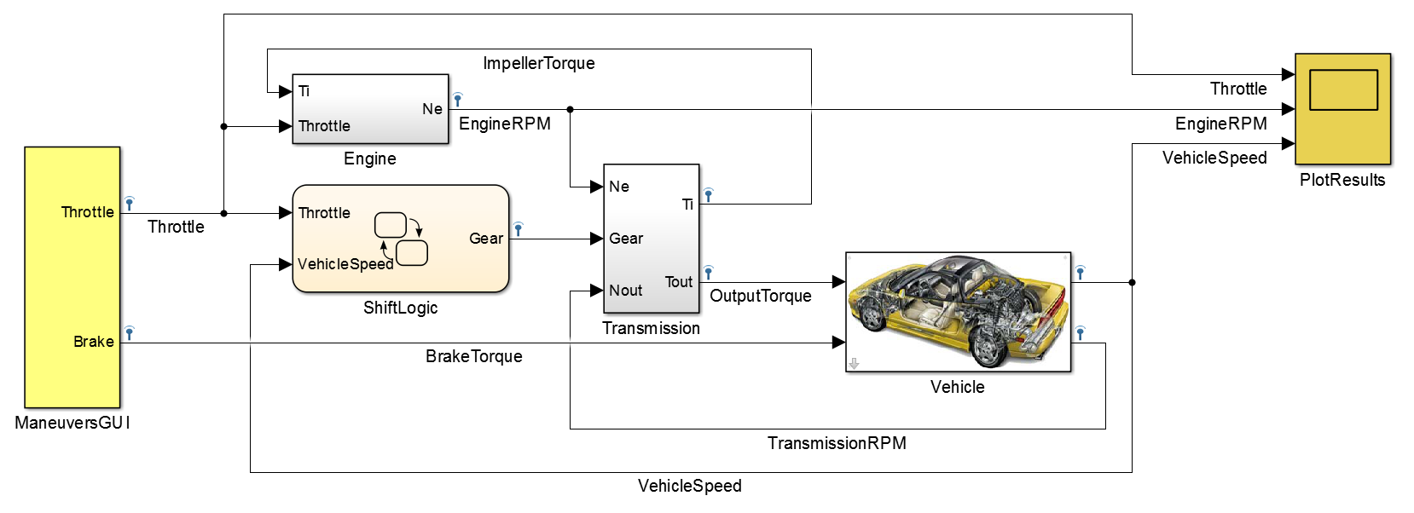

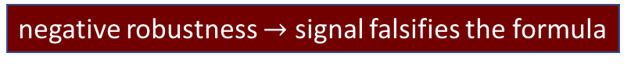




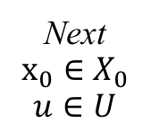
Falsification By Optimization
System Σ
MTL $φ$
x₀∈X₀
u ∈U
$$φ$$
y=Δ(x₀,u)
Robustness Metric
$$ε∈ℝ∪\{±∞\}$$
|ε|
$$Stochastic$$
Optimizer
|ε|
Next
$$x_{0}∈X_{0}$$
$$u∈U$$
positive robustness $→$ signal satisfies the formula
Minimum Robustness
after termination
condition met
negative robustness $→$ signal falsifies the formula
[Fainekos and Pappas, TCS]
[Abbas et al. TECS]

Slide 12
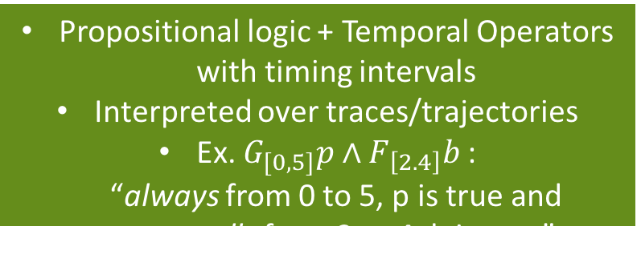
Metric Temporal Logic
Model
Propositional logic + Temporal Operators with timing intervals
Interpreted over traces/trajectories
Ex. $G_{[0,5]}p∧F_{\left[2.4\right]}b$: “always from 0 to 5, p is true and eventually from 2 to 4, b is true”
Simulink/Stateflow
User-defined functions
S-TaLiRo
Stochastic Optimization Engine
Features
Simulated Annealing
Cross Entropy
Ant-colony
Gradient Descent
Flexible initial condition and input signal generation
Falsification
Parameter Mining
Requirement Engineering with ViSpec
Runtime Verification
Conformance Testing
…
Notes:
Intro to MTL

Slide 13
3. Testing UxAS

Slide 14
Keep Out Zones
💨
GPS
$$Z_{1}$$
$$d_{n}$$
$$x_{fin},y_{fin}$$
$$alt$$
…
$$θ_{n−1}$$
$$v$$
$$d_{i}$$
$$θ_{i}$$
$$d_{1}$$
…
$$Z_{2}$$
$$x_{init},y_{init}$$
$$θ_{1}$$
Notes:
So, we want to create tasks and keep out zones under different opperating conditions and disturbances to find a violation.
But also…

Slide 15
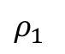
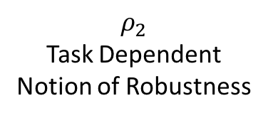
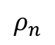
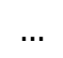

Autonomy Monitors
UxAS
Route Planner
Automation Request
Vehicle Abstract
Autonomy Monitor
…
Line Search
Area Search
Line Search
UAV Tasks
Assigned
$$ρ_{1}$$
$$ρ_{2}$$
Task Dependent
Notion of Robustness
$$…$$
$$…$$
$$ρ_{n}$$
UAV Tasks
Completed
Area Search Task
Autonomy Monitor
…
Notes:
We want to make sure that each UAV completes the assigned tasks.
We added an autonomy monitor service in UxAS and we created task dependent notions of robustness.
For each vehicle we monitor the robustness i.e. the completion of the task.

Slide 16
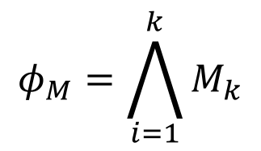
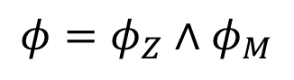
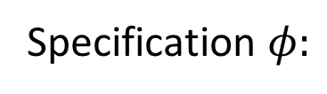
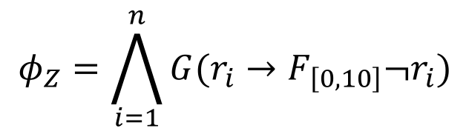
Testing UxAS with S-TaLiRo
$$φ_{Z}=\bigwedge_{i=1}^{n}{G(r_{i}→F_{\left[0,10\right]}¬r_{i})}$$
Keep Out Zones:
$$φ_{M}=\bigwedge_{i=1}^{k}{M_{k}}$$
Autonomy Monitors:
Specification $φ:$
$$φ=φ_{Z}∧φ_{M}$$
Notes:
We bring the two previous specificaitons together
“Whenever any of UAV 1, 2, … n enters the keep out zone $Z_{1}$ … $Z_{m}$, it should exit the zone in 10 seconds”

Slide 17
Stochastic Optimization
Scenario/Task
Specifications
Autonomy
Monitoring
Service
Temporal
Logic
Properties
Simulator
UxAS
AMASE
Disturbances
Property Monitors
Stochastic
Global
Optimizer
Notes:
We modify the scenario/task specifications and disturbances -> run the uxas/amase -> analyze the traces -> choose next sample

Slide 18
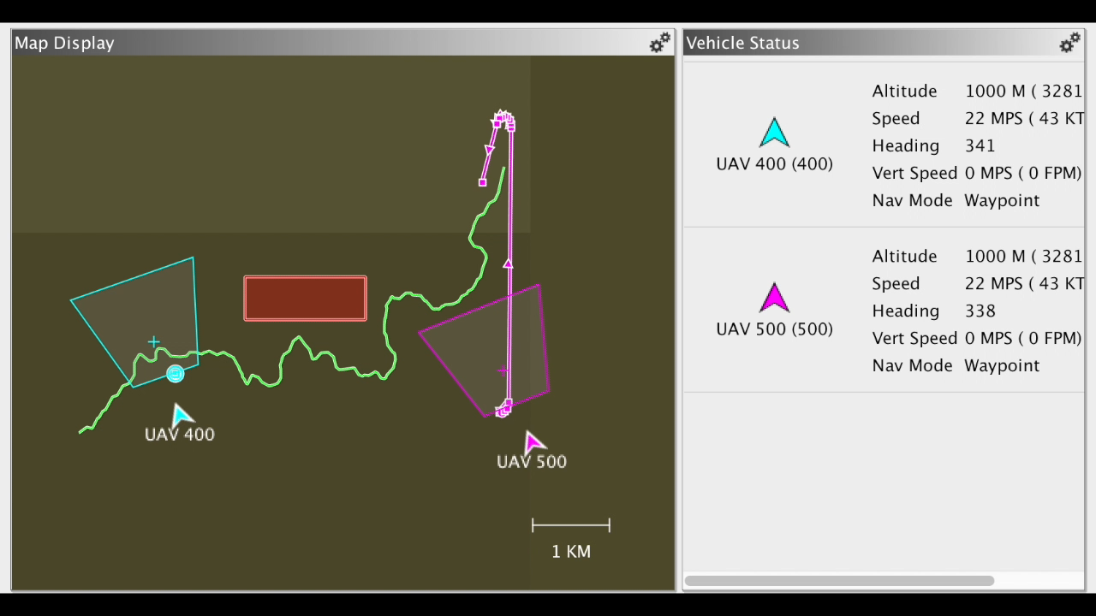
Result: Falsification
https://youtu.be/tVB9TgwrCEc
Notes:
6 different wind gust throughout the simulation and the direction changes
Gaussian noise – GPS
Wind modeled – Direction and Speed for 6 time periods
Wind and GPS should be tolerable for the system
When we started, UxAS had about 5 unit tests which they ran after every change in the system to ensure proper system operation
They take significant time to develp.
Wthis approach we can add 100-1000 of them and all of this is done automatically.

Slide 19
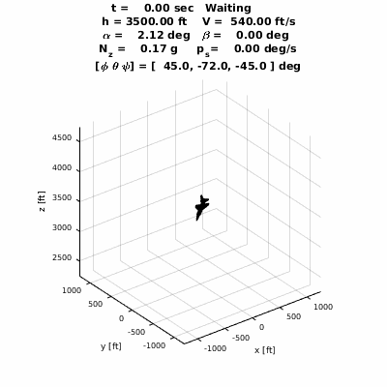
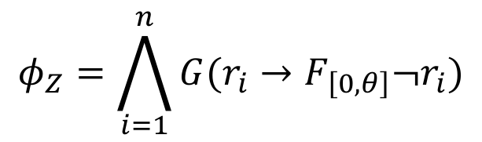
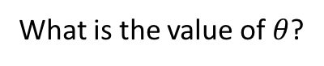
Future Work
1. Parameter Mining of MTL Specs [Hoxha et al. STTT]
What is the value of $θ$?
$$φ_{Z}=\bigwedge_{i=1}^{n}{G(r_{i}→F_{\left[0,θ\right]}¬r_{i})}$$
2. More complex vehicle dynamics
Ex: F16 Aircraft Model
[Bak and Heidlauf]
github.com/pheidlauf/AeroBenchVV
Notes:
The smaller theta the stricter the specification. And due to monotonicity properties we can use stochastic optimization to determine this
ground collision avoidance

Slide 20
Acknowledgments
AFRL:
Derek Kingston
Laura Humphrey
VU:
Taylor Johnson
Luan Viet Nguyen
UT Austin:
Ufuk Topcu
Mohammed Alshiekh
ASU:
Adel Dokhanchi
Shakiba Yaghoubi
Cumhur E.
Tuncali
Georgios
Fainekos
Guohui
Ding
Sriram
Sankaranarayanan
Sponsors:

Slide 21
Thank You
Questions?
MTL Survey
Test hypothesis that formal methods experts can write correct MTL specifications from NL
www.bit.ly/2HKsMQK

